Slide 1
Symbolic Mathematics
Toby Davis U6VS – Help Project 2022
Notes:
This presentation describes things in order of development, not algorithm priority

Slide 2
Contents
What is symbolic mathematics, and why is it useful?
What already exists, and what are the flaws with those systems?
How can we implement a system capable of processing equations symbolically?
How can this be implemented in C++, and what are the challenges associated with this?
The data structures and algorithm layout
Implementing the parser
Evaluating expressions
Working with functions

Slide 3
Contents (cont.)
Computing a derivative
Simplifying equations
Advanced functionality
Benchmarks and scope for further optimization

Slide 4
What is Symbolic Mathematics?
A Basic Introduction

Slide 5
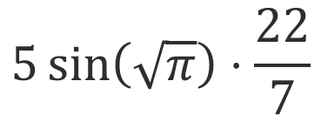
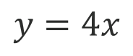
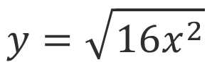
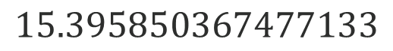
What is Symbolic Mathematics?
Computers are good with numbers
Humans are good with symbols*
$$5\sin\left(\sqrt{π}\right)⋅\frac{22}{7}$$
$$y=\sqrt{16x^{2}}$$
$$15.395850367477133$$
$$y=4x$$
How can we program a computer to do both?
* Relatively speaking.
Notes:
Computers are good at numeric calculations
Cannot deal with symbolic equations
We’re used to symbolic equations

Slide 6
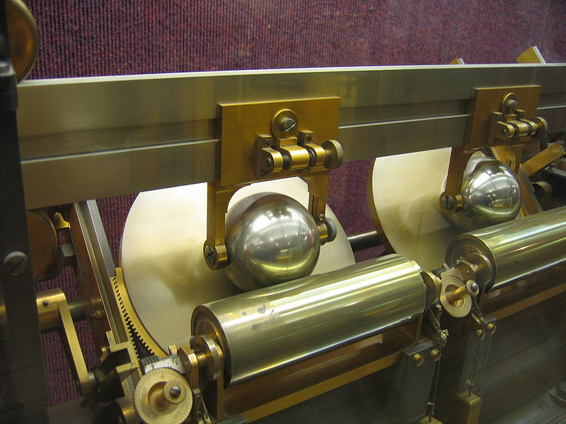
Why is Symbolic Mathematics Useful?
Since the invention of the first computers, our understanding of mathematics has increased dramatically.
The first electronic computer, the ENIAC, did more calculations during it’s lifetime than the entire human population until that time.
This includes mechanical computers!
Manipulating and solving symbolic expressions provides a new tool to tackle more problems than ever.

Slide 7
Why is Symbolic Mathematics Useful? (cont.)
Some problems are too complex for humans to solve
Some problems are too large for humans to solve
Useful in scientific applications, where exact results are required
Required for visual solvers (e.g., Mathematica, Wolfram Alpha and Desmos)
Useful for step-by-step solutions (e.g., Photomath)
Extremely useful where exact answers are required, not just approximations (much more on this later)

Slide 8
What Already Exists?
Existing Software, Frameworks and Libraries

Slide 9
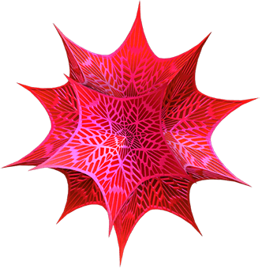
Wolfram Mathematica
Based on the Wolfram Language, it is capable of manipulating and solving incredibly complicated equations.
It has been used in many ground-breaking research projects.
Unfortunately, it costs over £100 to use, and doesn’t integrate with other software.

Slide 10
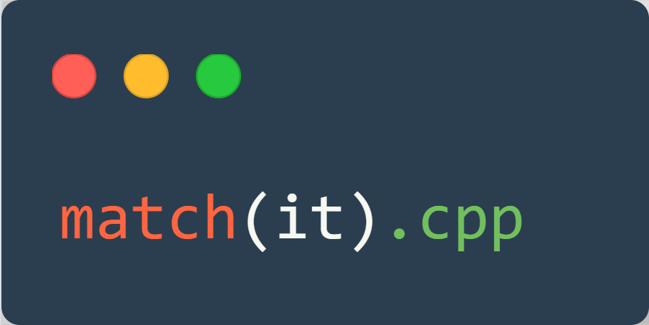
mathui.cpp
Uses a pattern matching system to evaluate expressions.
Far more limited than Mathematica
Overall, a very effective system, though with limited equation solving and no integration functionality.

Slide 11


SymEngine (and Derivatives)
An incredibly powerful C++ library for symbolic mathematics
Is able so solve, differentiate and integrate equations as well as much more.
Is a key dependency for many other math libraries, such as SymPy, for Python
Unfortunately, it is a very large framework and is difficult to compile without specific tools. It also requires other libraries to be installed, which is difficult for some users.

Slide 12
What Can Be Learned From These?
A recursive, pointer-based approach seems to be optimal
Many libraries are simply too large to be used in small-scale projects
Lightweight libraires often lack functionality
A fully featured symbolic mathematics implementation should support the following:
Evaluation of numeric equations
Simplification
Integration and Differentiation
Series simplifications
A wide range of built-in functions
Note: Some of these features are incredibly complex, and are far beyond the scope of this project.

Slide 13
How Can This Be Implemented?
Exploring potential implementation methods and their pros/cons

Slide 14
What Does the System Need to be Capable of?
The ability to store an equation containing scalars, operations, functions and more
A means of evaluating a given equation, given it contains only numbers
A way to substitute values for variables (not necessarily substituting scalars)
Methods for differentiating and integrating equations symbolically
The ability to reduce an equation into its simplest form

Slide 15
Implementation I – Compile-Time Evaluation
All datatypes are defined at compile-time
All equations are known by the compiler (i.e., they are actual functions)
Pros
Cons
Extremely fast
Potentially easier to implement
Potentially easier to use within the context of C++
Expressions must be known at compile-time
Cannot easily be ported to other languages
Slow to compile complex equations due to templatization of functions

Slide 16
Implementation II – Runtime Evaluation
Almost everything is defined at runtime
Core functions, operations and algorithms are implemented at compile-time
A tree-like structure can be used to store the equation – this is efficient in terms of both memory and processing
Pros
Cons
Expressions are defined at runtime
All processing is done at runtime, meaning greater freedom and customizability
Quick to compile and lightweight
Easy to use ABI in other languages, as there is no need for template functions
Slower than compile-time defined system
A parser must be implemented to process user input
Difficult to implement in statically typed languages

Slide 17
Decisions Made For This Project
Implement a runtime system for symbolic mathematics
Written using C++
Only differentiation will be implemented, though methods for integration will be explored
Only a few rules will be implemented (explained later)
This reduces the length of the program and saves time
Additional rules are trivial to add
The program will be a proof-of-concept, not a fully functioning library

Slide 18
Implementing the Parser
The algorithms which process an equation and generate a tree

Slide 19
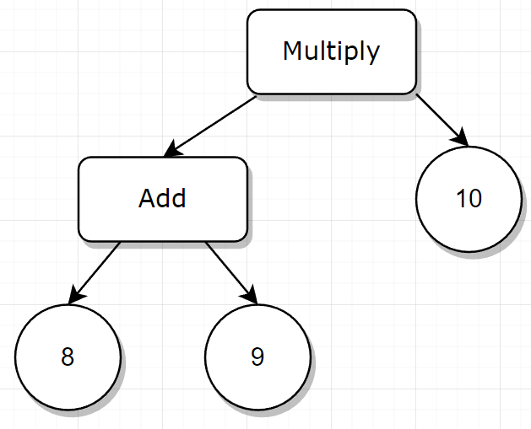
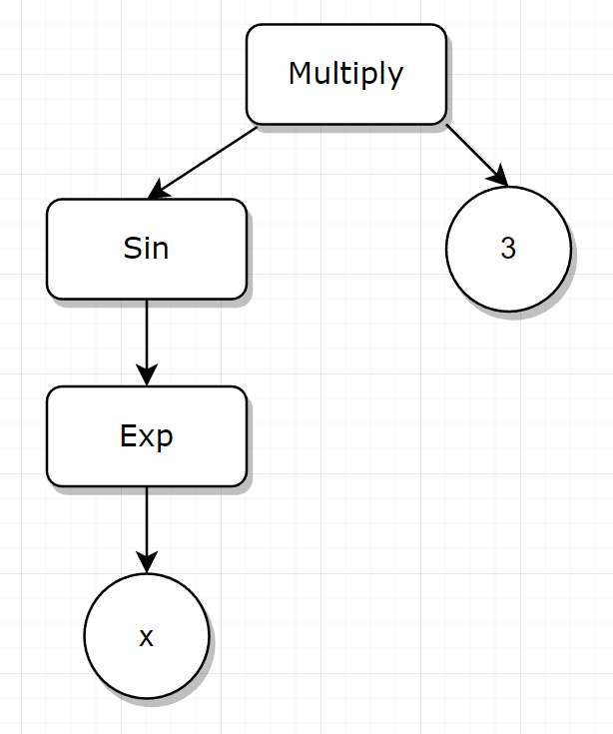
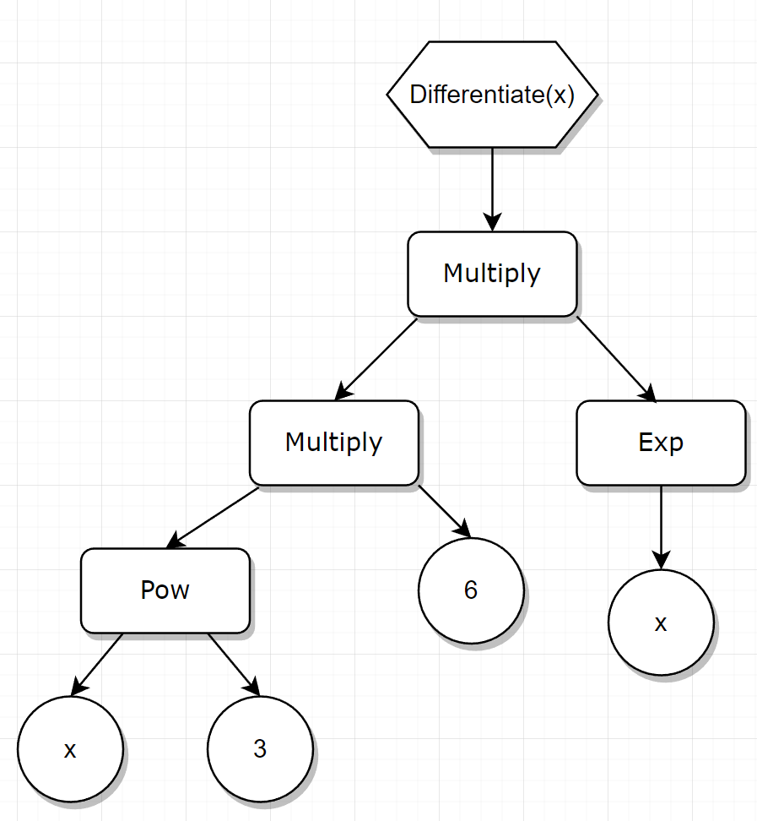
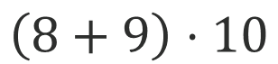
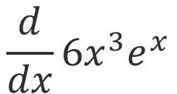
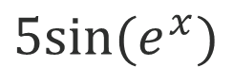
The Goal of the Parser
$$\frac{d}{dx}6x^{3}e^{x}$$
$$\left(8+9\right)⋅10$$
$$5sin⁡(e^{x})$$

Slide 20
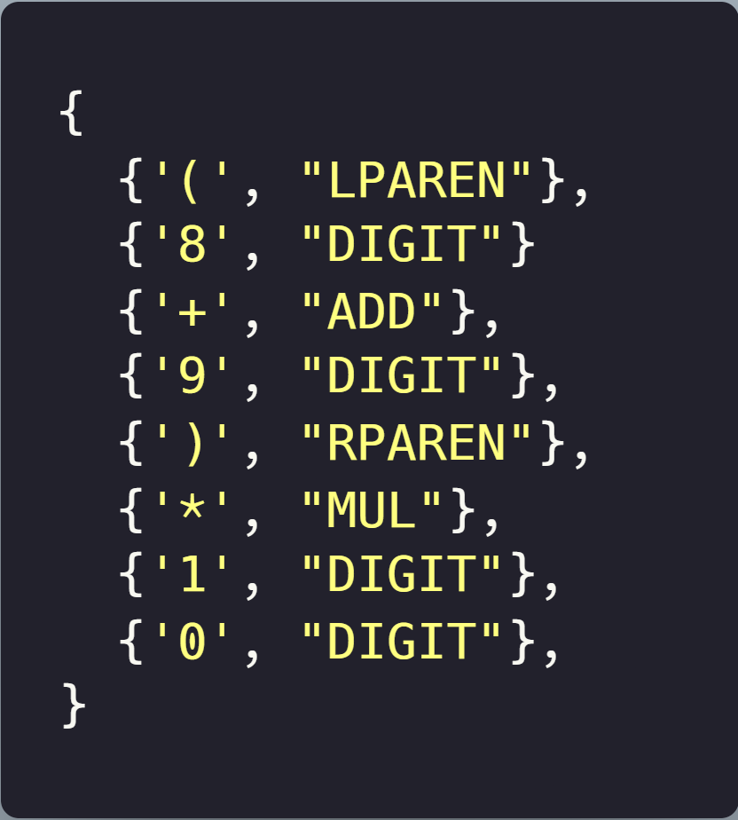
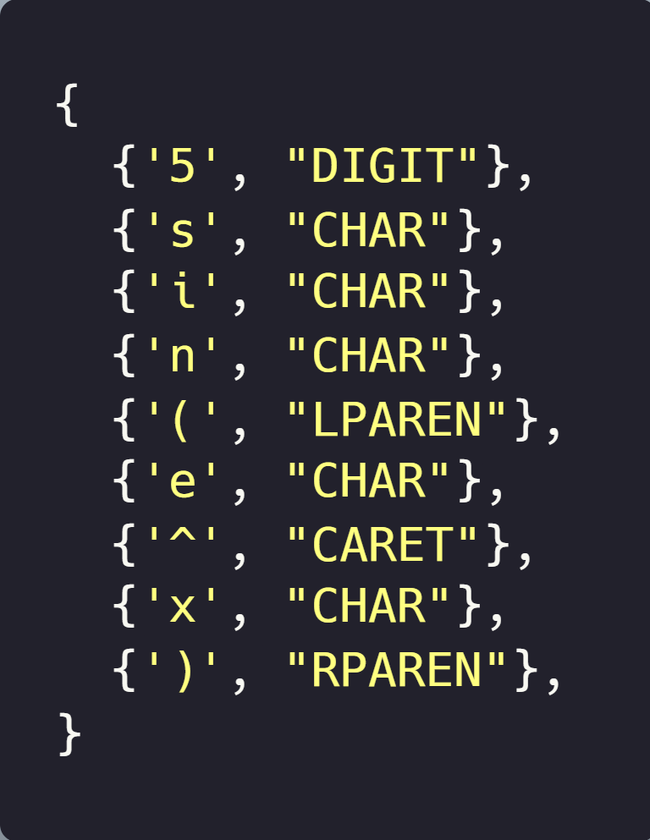
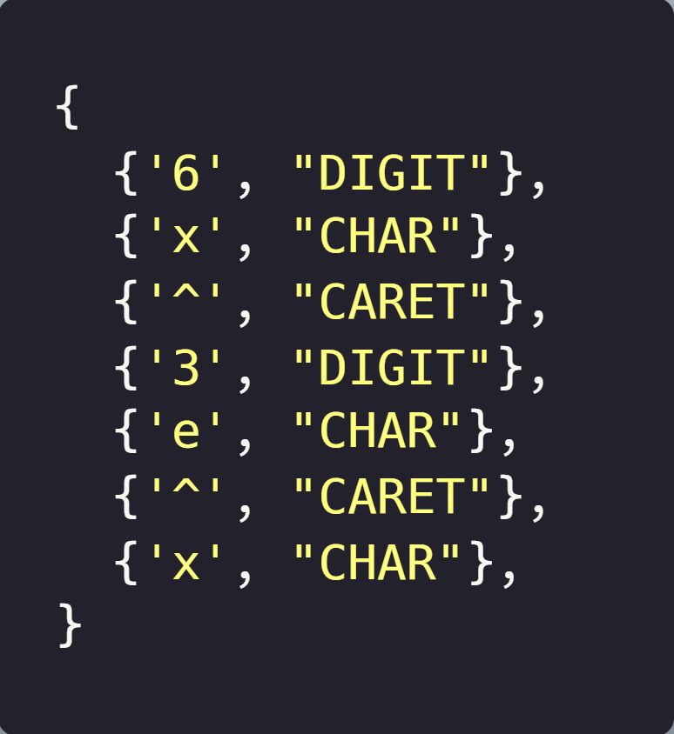
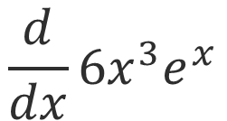
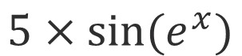
Stage 0 – Tokenizing
Note: The derivative will not be typed explicitly, it will be called as a function in the C++ code.
$$\frac{d}{dx}6x^{3}e^{x}$$
$$\left(8+9\right)⋅10$$
$$5×sin⁡(e^{x})$$
(8+9)*10
5*sin(e^x)
diff(6x^3e^x)

Slide 21
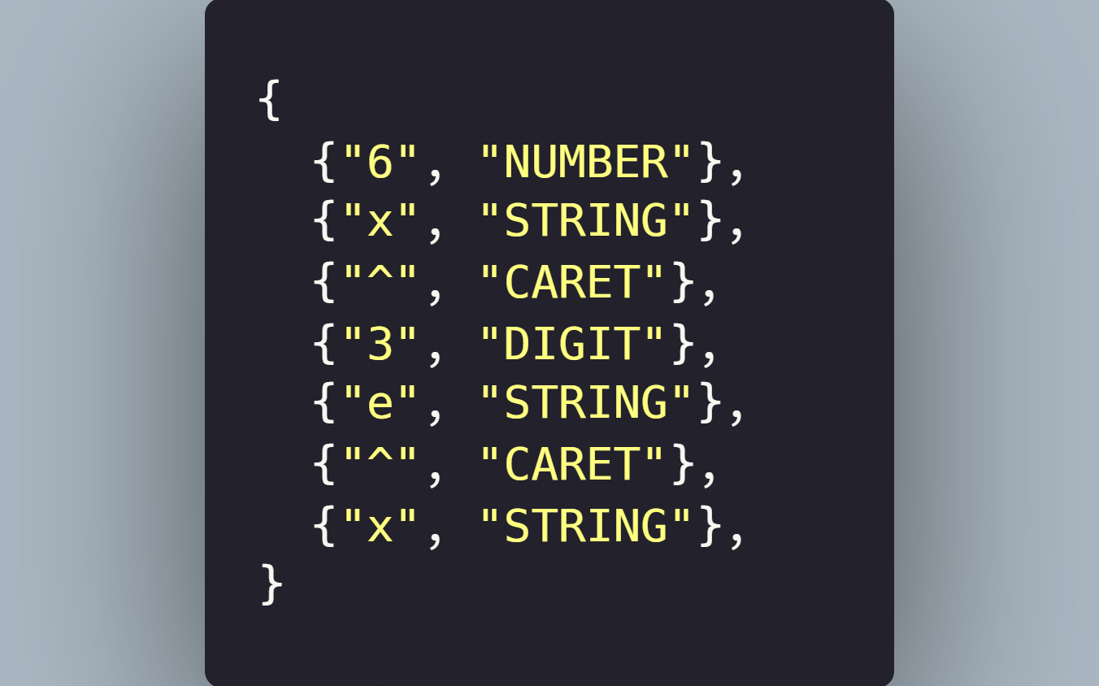
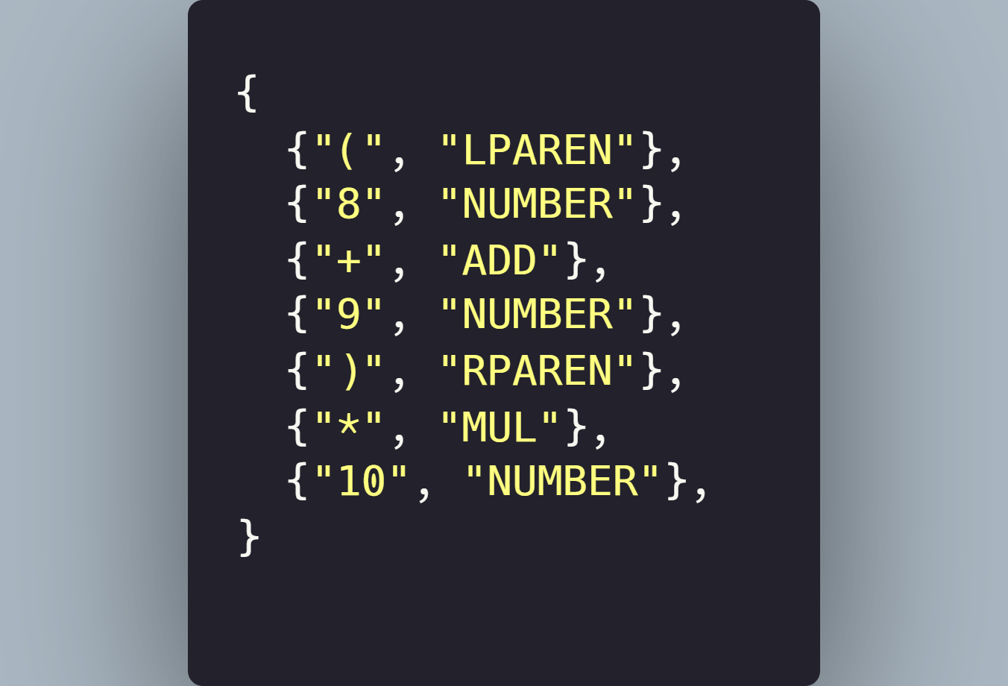
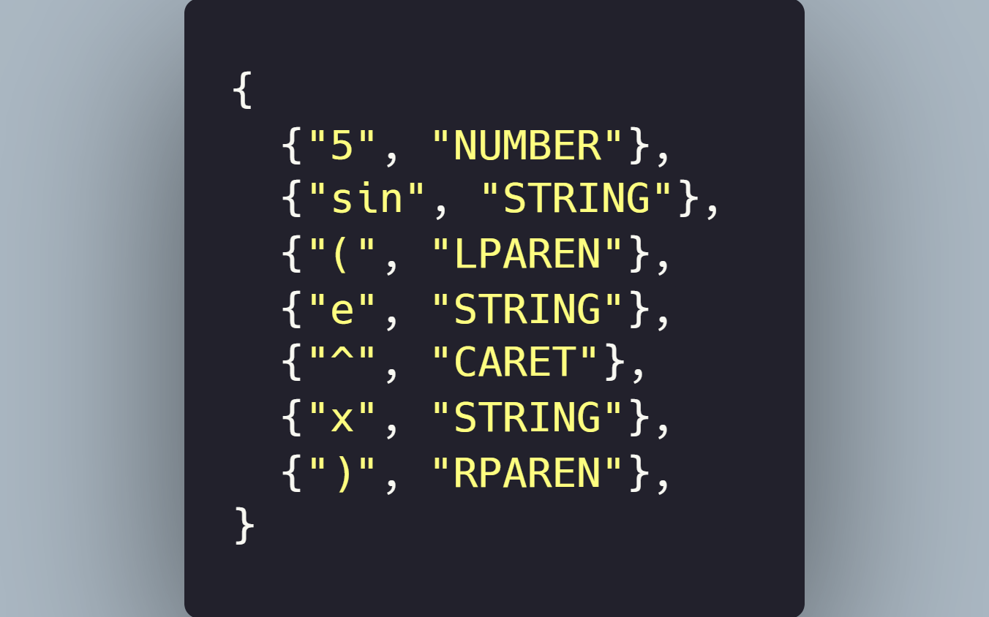
Stage 1 – Lexing

Slide 22
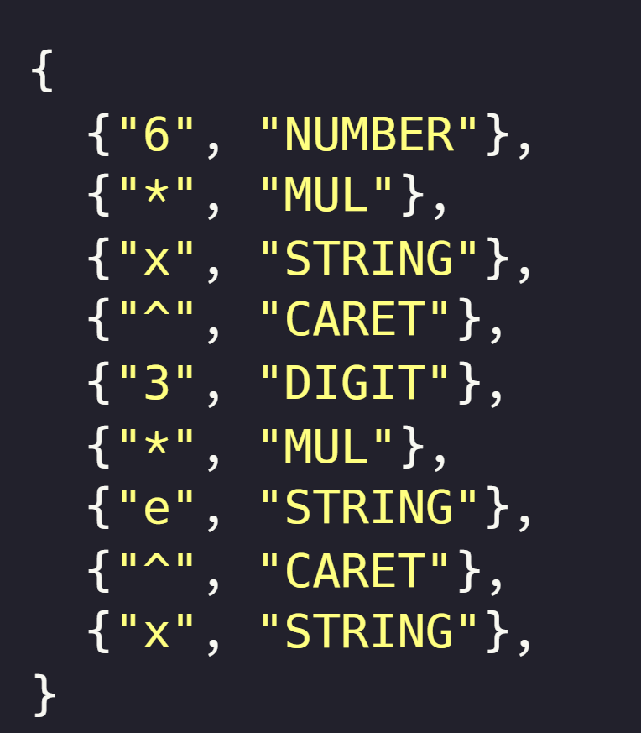
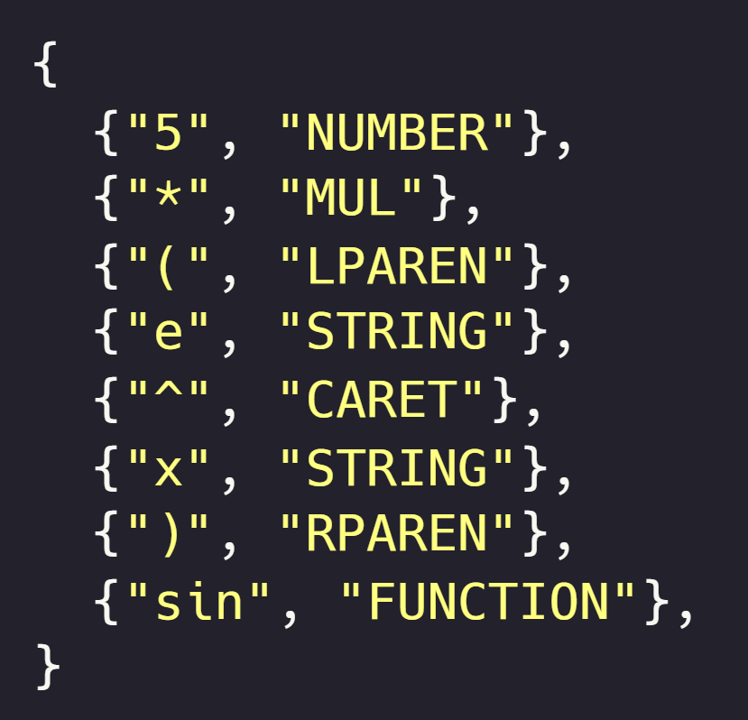
Stage 2 – Processing

Slide 23
Stage 3 – Infix to Postfix
Postfix notation is another way of representing an equation
(8+9)*10
8 9 + 10 *
5*sin(e^x)
5 e x ^ sin *
Operator precedence is not needed – order of operations is explicit
6*x^3*e^x
6 x 3 ^ * e x ^ *
The operator goes after the operands (hence, postfix)
This order of operations is much easier for a computer to handle

Slide 24
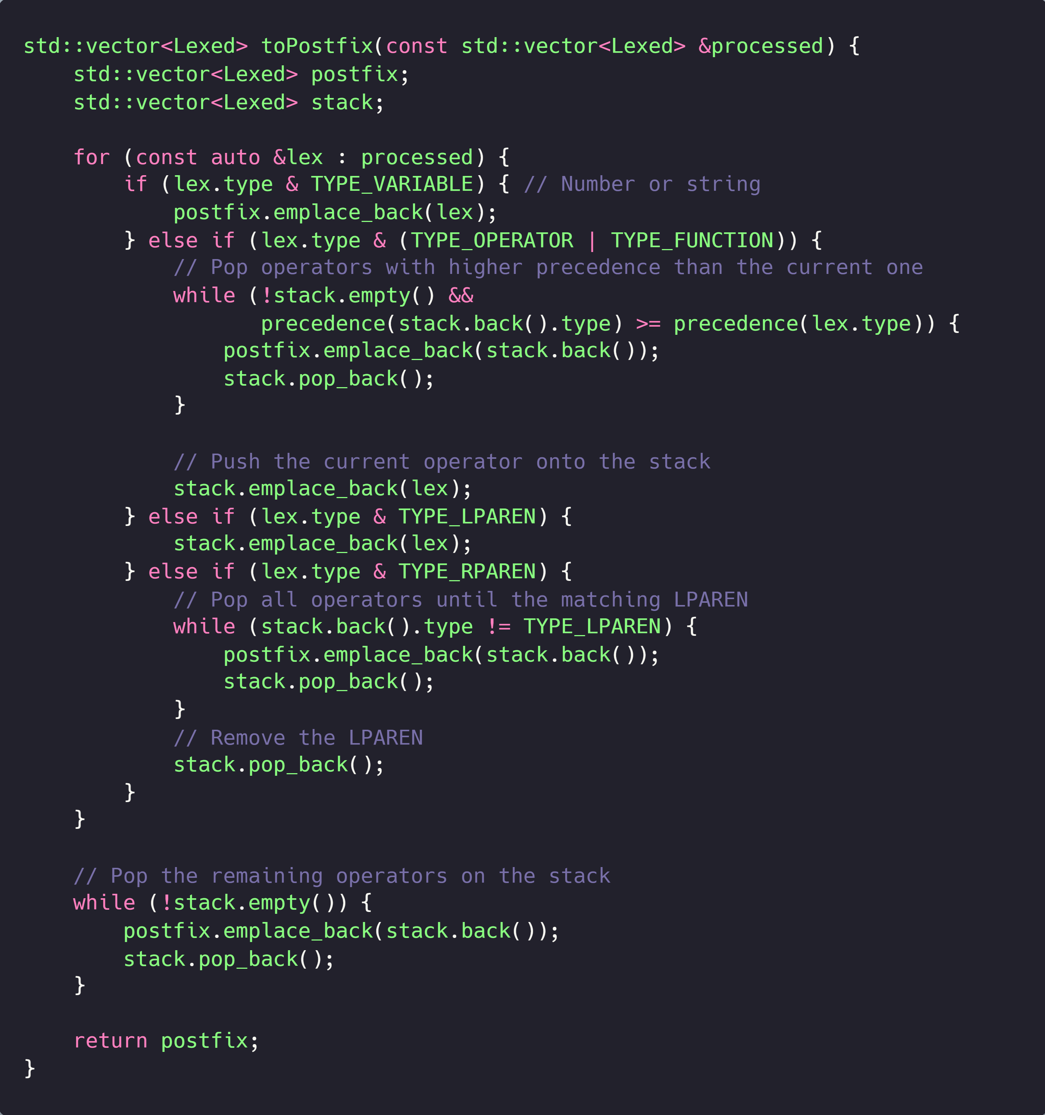
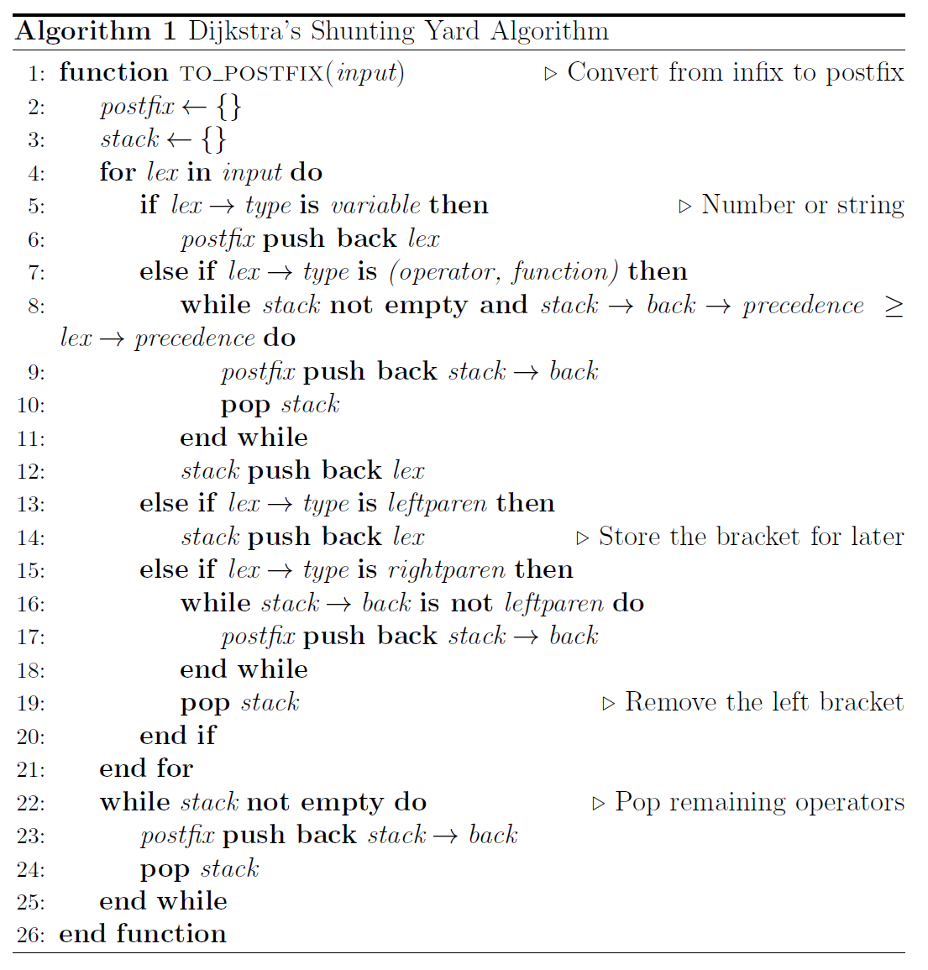
Stage 3 – Infix to Postfix

Slide 25
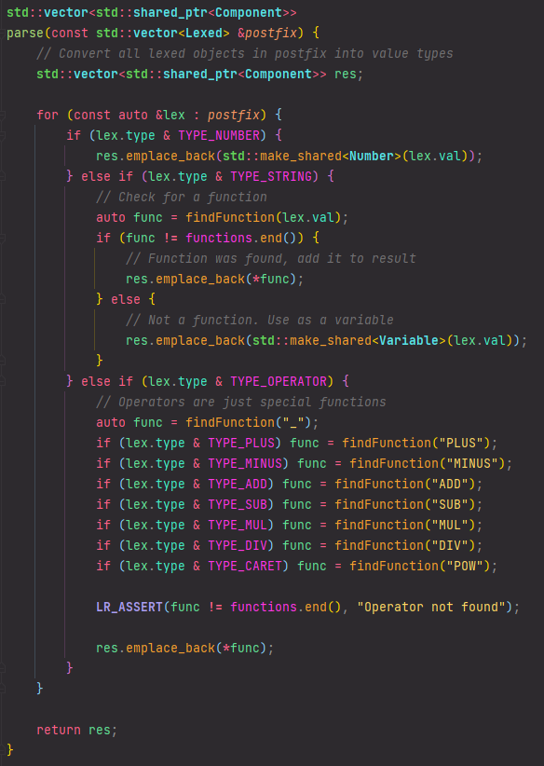
Stage 4 – Parsing the Results
This step iterates over each lexical token in the postfix equation
It converts each value into something the computer can now use efficiently

Slide 26
Implementing Data Types
The core data types which store all the information about an equation

Slide 27
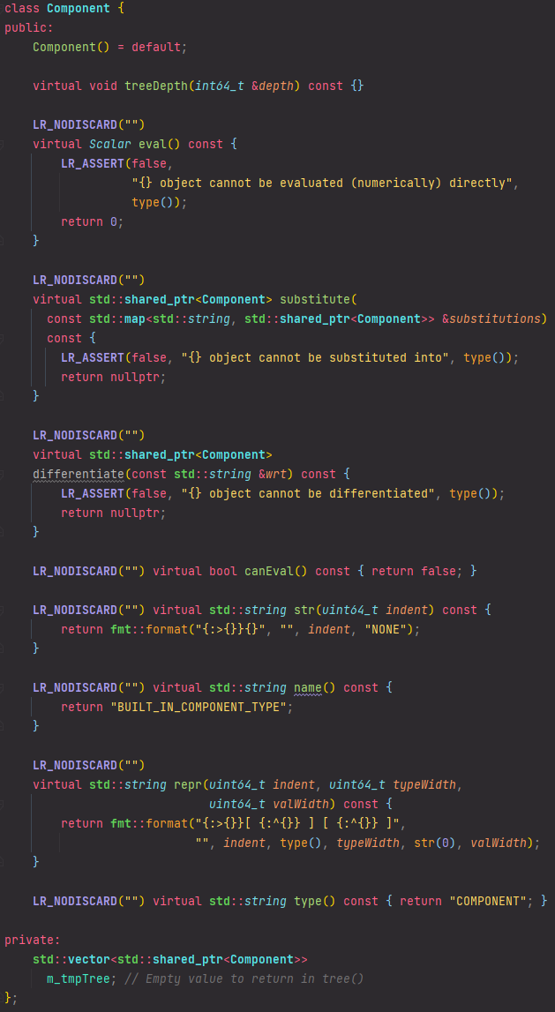
The Component Class
This project implements a polymorphic data structure. This allows us to avoid C++’s static typing.
The Component class implements virtual functions, which are intended to be overridden by the other data types.
The main functions are:
eval
substitute
differentiate
name

Slide 28
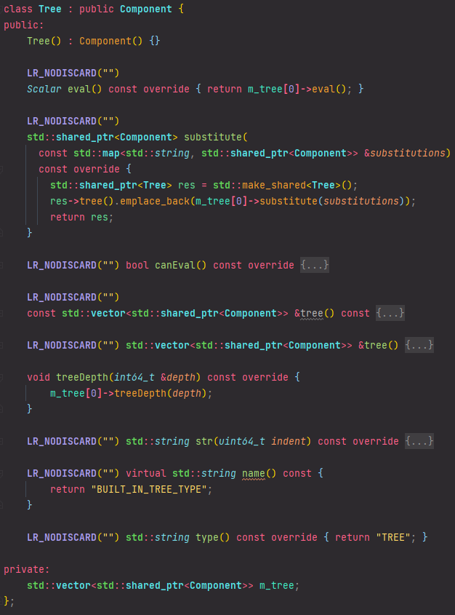
The Tree Class
This stores an equation and provides some helper functions, such as pretty-printing.
This class isn’t strictly necessary, but it does make the development easier. For a higher-performance implementation, this class could be excluded. More on this later.

Slide 29
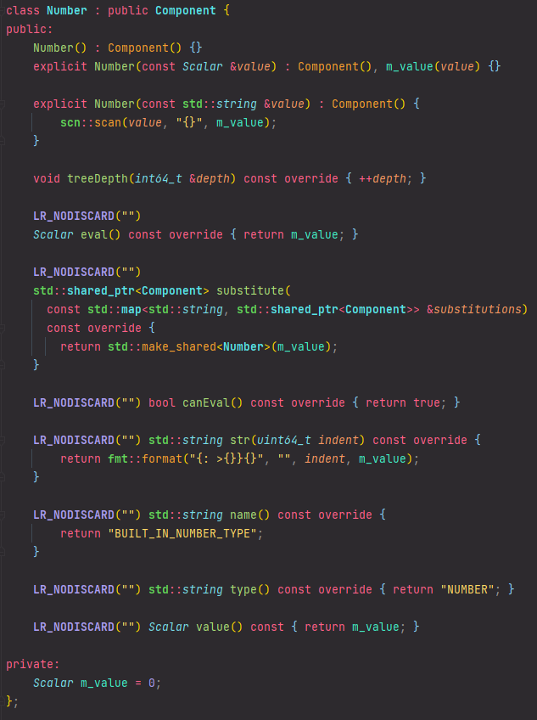
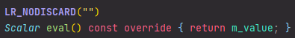
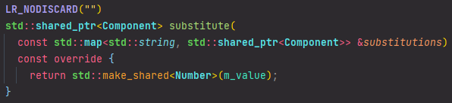
The Number Class
This stores a single scalar value, and allows access to it via it’s eval member.

Slide 30
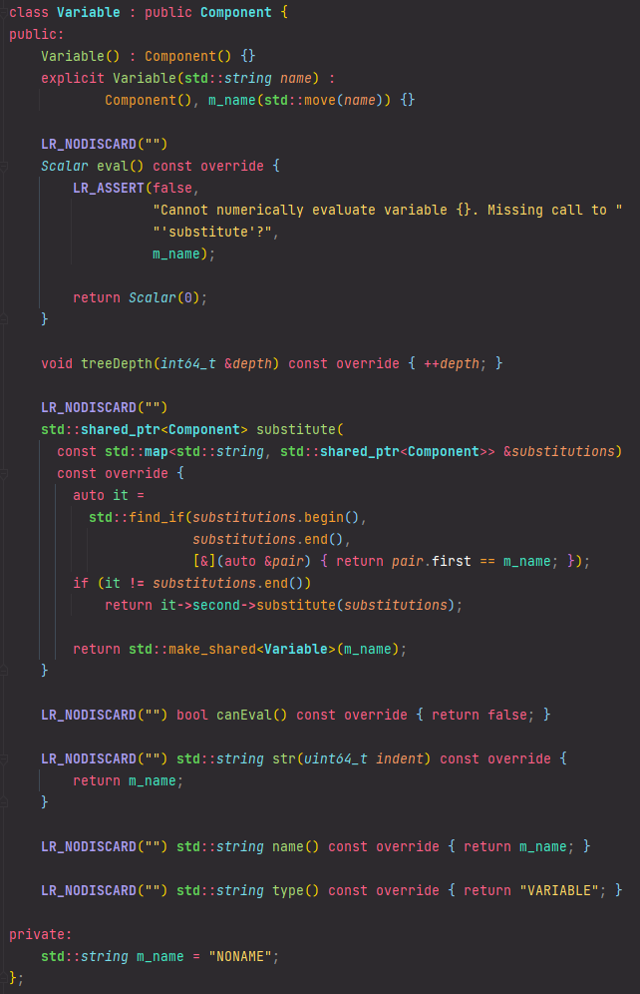
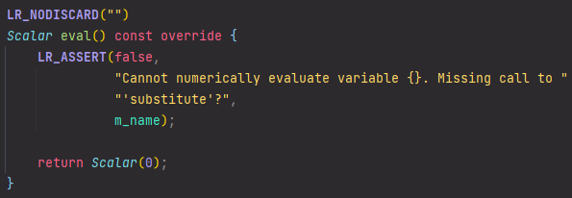
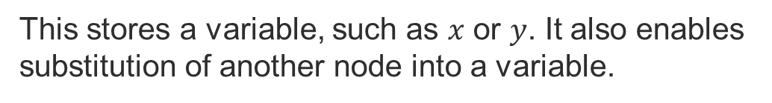
The Variable Class (evaluation)
This stores a variable, such as $x$ or $y$. It also enables substitution of another node into a variable.
A variable cannot be numerically evaluated without a value substituted in, and hence the eval method will always error.

Slide 31
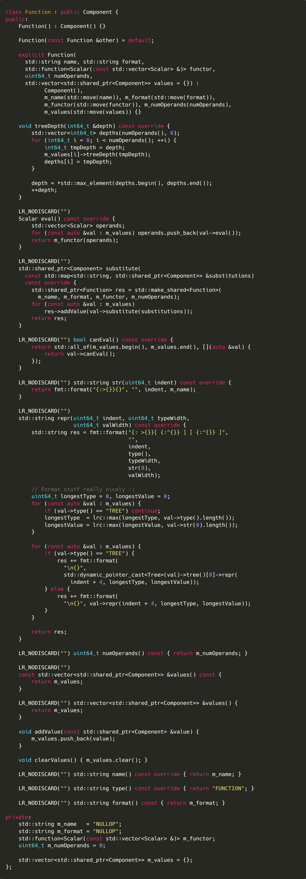
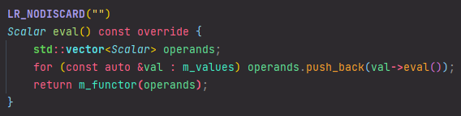
The Function Class (evaluation)
The Function class is the most complex data type in the project, as it must perform a wide range of different operations.
The eval method of the Function class takes all of its operands, evaluates them, and then passes them to it’s functor member

Slide 32
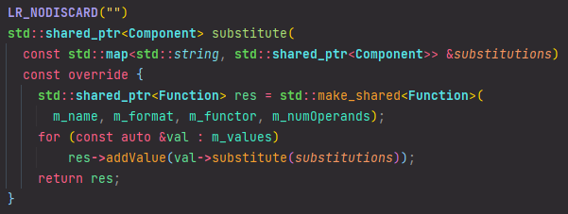
The Function Class (substitution)
To substitute a value into the Function node, a copy of the function is made and each operand of the function is added into the copy, after being evaluated.

Slide 33
Generating the Final tree
Producing a tree object from the parsed equation in postfix notation

Slide 34
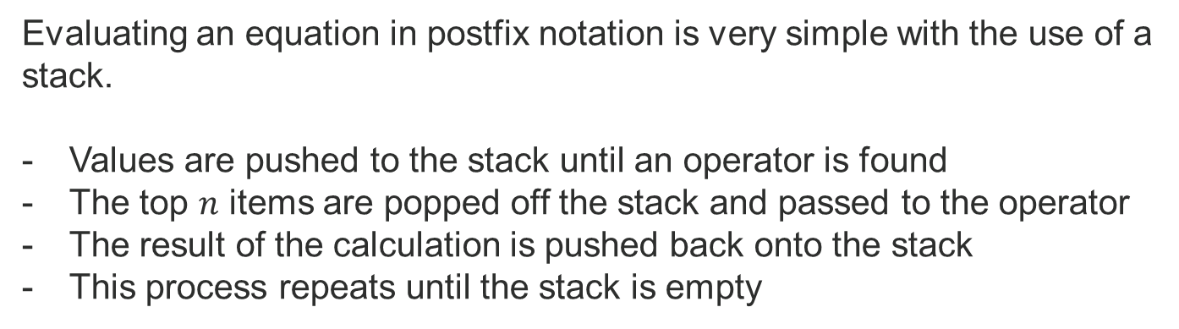
Evaluating Postfix Notation
Evaluating an equation in postfix notation is very simple with the use of a stack.
Values are pushed to the stack until an operator is found
The top $n$ items are popped off the stack and passed to the operator
The result of the calculation is pushed back onto the stack
This process repeats until the stack is empty

Slide 35
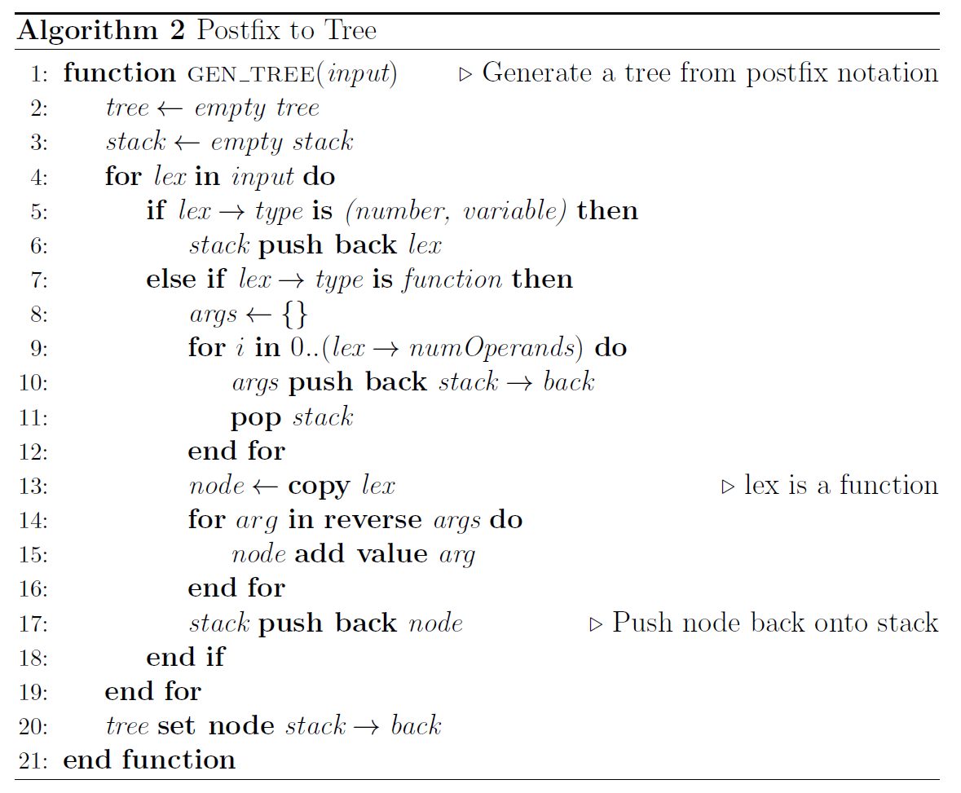
Generating a Tree, Not a Number
In order to produce a Tree object, instead of a numeric result, a small alteration is required to the typical postfix evaluation algorithm.
Instead of pushing the numeric result from an operator, a new Function object is created with the corresponding operands.

Slide 36
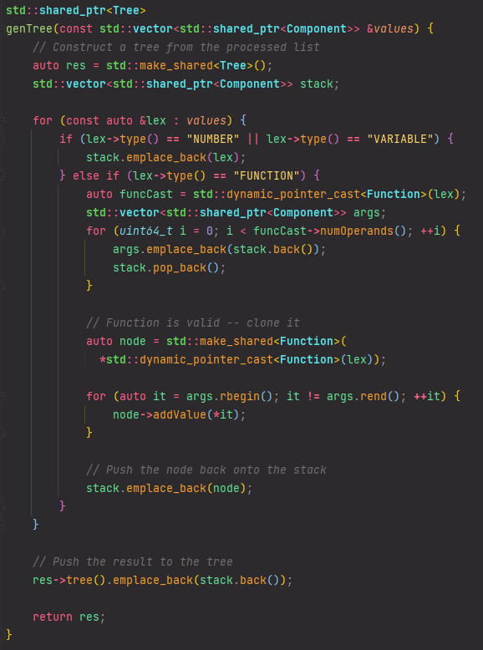
Generating a Tree, Not a Number
To implement a stack, an std::vector is used. This has a method to pop off the last element and has a variable size, and therefore can be used as if it were a stack.
Each Function object supports an addValue method, which adds an operand to the Function.
If an incorrect number of operands are added to a function, the program will raise an error.

Slide 37
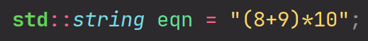
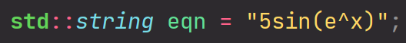
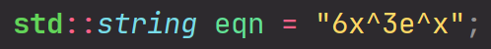
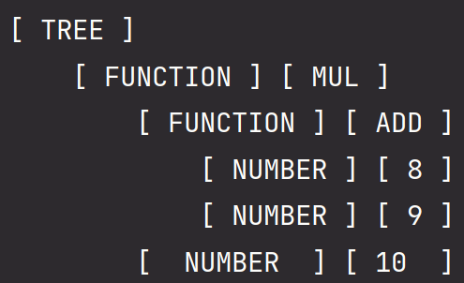
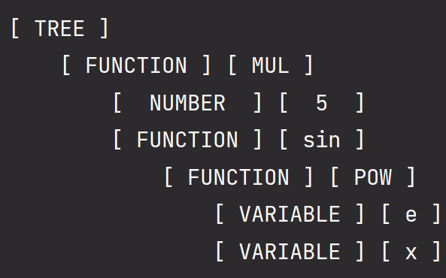
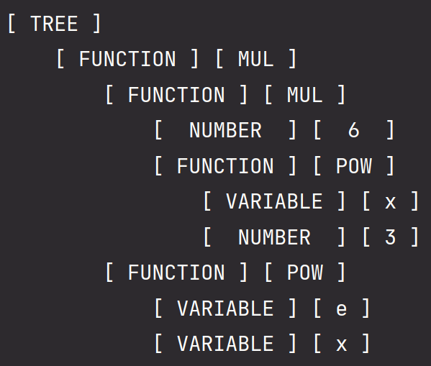
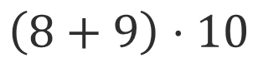
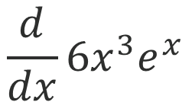
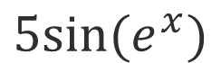
Testing This Approach Works
Remember, the derivative will be applied by a separate function (covered later)
Let’s now go back to the examples shown before and check whether we get the same output.
$$\frac{d}{dx}6x^{3}e^{x}$$
$$\left(8+9\right)⋅10$$
$$5sin⁡(e^{x})$$

Slide 38
Differentiation
Computing a derivative recursively

Slide 39
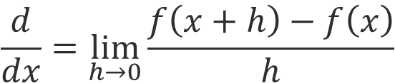

Problems with Numeric Differentiation
To compute a derivative with a computer, it’s possible to take the definition of the derivative and approximate it.
$$\frac{d}{dx}=\lim_{h→0}{\frac{f\left(x+h\right)−f\left(x\right)}{h}}$$
$\frac{d}{dx}≈$ $\frac{f\left(x+ε\right)−f\left(x\right)}{ε} where |ε|≪1$

Slide 40


Problems with Numeric Differentiation
This approach has many issues – mainly due to floating point limitations.

Slide 41

Implementing Symbolic Differentiation
Because the equation is represented as a tree, we can traverse it recursively and differentiate each node, producing a new tree which represents the symbolic derivative of the original equation.
The rules on the left can be applied recursively to each node.

Slide 42



Derivative of a Scalar or Variable
$$\frac{d}{dx}a=0 for a∈ℝ$$
$$\frac{d}{dx}x=1$$
If node is a number, derivative is zero
If node is a variable
If variable name equals W.R.T., gradient is one
Otherwise, gradient is zero

Slide 43


Derivative of Addition and Subtraction
$$\frac{d}{dx}f\left(x\right)±g\left(x\right)=\frac{d}{dx}f\left(x\right)±\frac{d}{dx}g(x)$$
Extract the operands of the operation
Differentiate LHS and RHS
Create a new addition/subtraction node
Set the differentiated values as operands
Return the new node

Slide 44


Derivative of Multiplication
$$\frac{d}{dx}f\left(x\right)g\left(x\right)=g\left(x\right)\frac{df}{dx}+f\left(x\right)\frac{dg}{dx}$$
Extract the operands of the operation
Differentiate LHS and RHS
Create a multiplication node
Derivative of LHS
RHS
Create another multiplication node
LHS
Derivative or RHS
Create addition node
Both multiplication nodes

Slide 45


Derivative of Division
$$\frac{d}{dx}\frac{f\left(x\right)}{g\left(x\right)}=\frac{g\left(x\right)\frac{df}{dx}−f\left(x\right)\frac{dg}{dx}}{g{\left(x\right)}^{2}}$$
Same process as for multiplication, except with subtraction instead of addition, and an extra division node at the end

Slide 46








Testing These Rules
We can now test if the differentiation algorithm works correctly by running it on some simple equations.

Slide 47
Simplification
Simplifying equations – in particular, the results of differentiation

Slide 48

How is Simplification Implemented?
Simplification is implemented in the same way as differentiation.
We define certain patterns and rules, and these are applied recursively to each node in the tree.
Currently, only very simple rules are defined, however it would be easy to design more advanced ones to further simplify equations.

Slide 49

How Effective is This Solution?
Here is the example from before:
The rules defined previously will be very effective for the results of differentiation.
Unfortunately, they are less useful in more general cases.
Luckily, it is very easy to add new rules.
Here’s the result after applying these rules:
It’s not perfect, but it’s clear to see how implementing more rules could further simplify this.

Slide 50
Some Simple Benchmarks
How fast is this implementation?

Slide 51

How Efficient is This Implementation?
It’s clear that the tree generation stage takes the longest, and that the numeric evaluation is the fastest stage.

Slide 52
Any Questions?

